Slide 1
Metallic Fuel Microstructural and Performance
NE 591

Slide 2
Last time
Corrosion is the environmental degradation of materials
Cladding oxidizes, forming ZrO₂
The limiting step for oxidation is the oxygen transport through the oxide layer
It begins being controlled by diffusion
Then, a protective layer forms that slows oxidation
Hydrogen released by oxidation enters the cladding
Due to low solubility (that is a function of temperature), hydrides form
Hydrides are brittle, and so reduce the ductility of the cladding

Slide 3
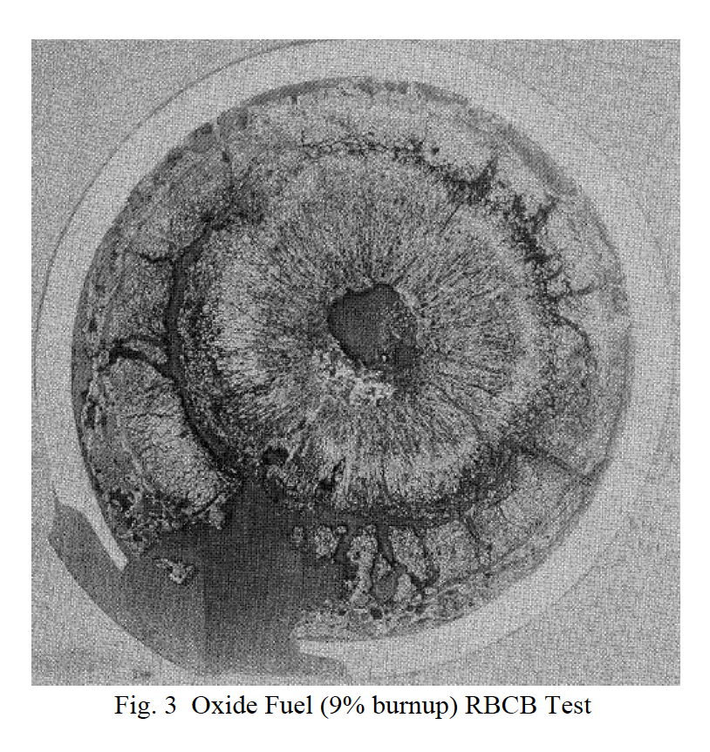
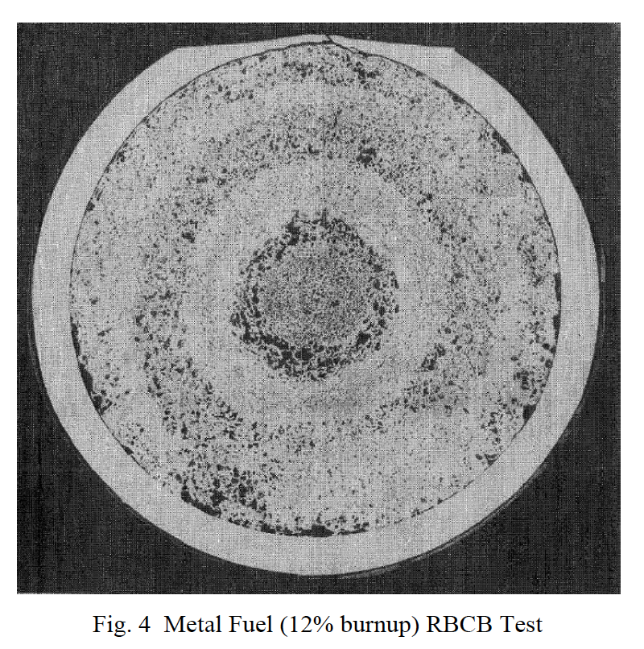
Why metallic fuel?
It has demonstrated a high burnup capability beyond 20%
Metal fuel also has superior off-normal performance characteristics, in particular for the run-beyond-cladding-breach conditions due to the compatibility of metal fuel with sodium coolant
the inherent passive safety potential where metal fuel is far superior to other fuel types
Metal fuel also allows a very simple injection-casting fabrication technique and electrorefining-based fuel cycle closure, which promises simpler waste management, proliferation-resistance, and much improved economics

Slide 4
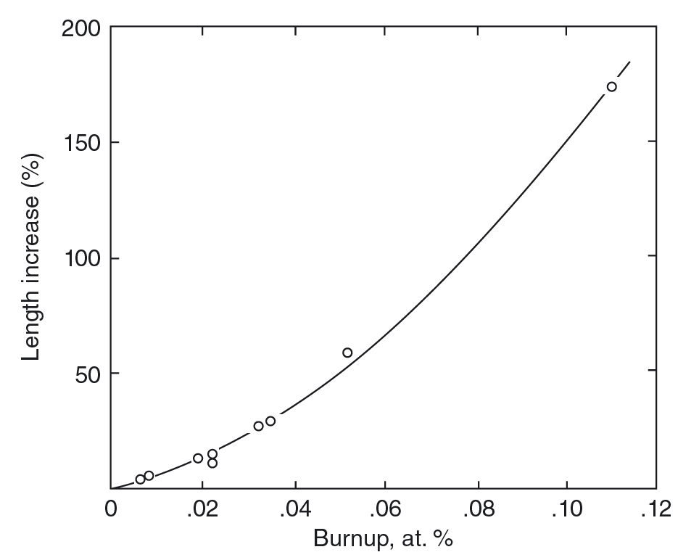
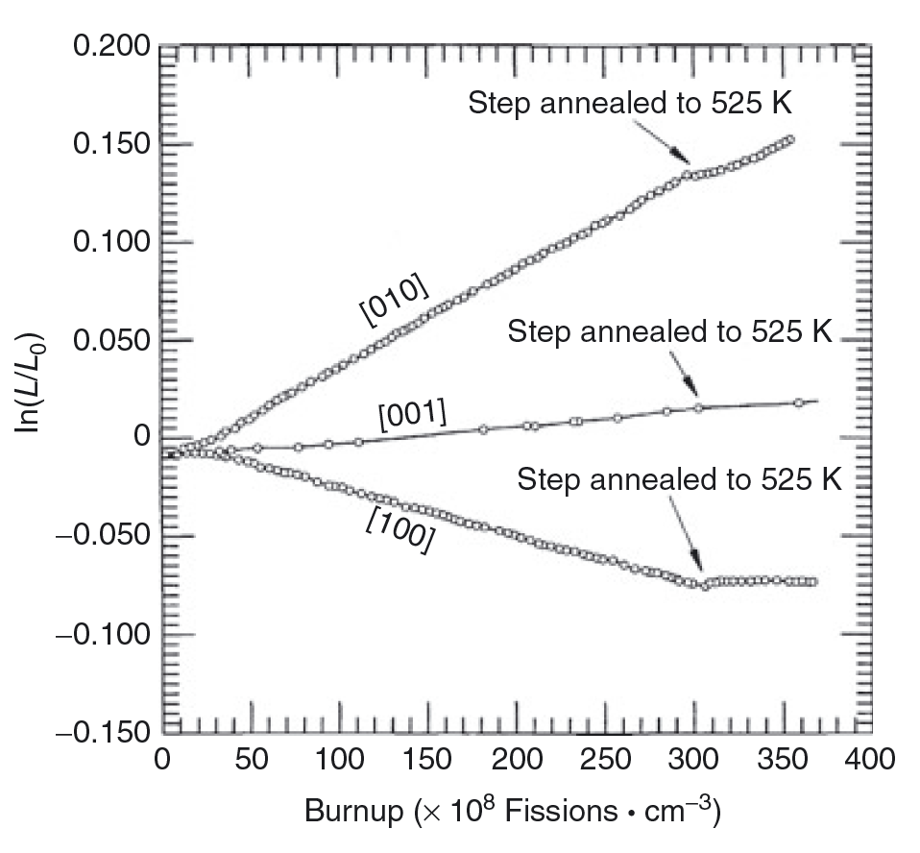
Why do we alloy?
Unalloyed swelling can reach >150% at target burnups
Anisotropic swelling of alpha U
thermal expansion
irradiation growth
Cavitation swelling is characterized by large irregular cavities that form by mechanical tearing at grain and sub-grain boundaries, resulting in a very deformed “swirled” microstructure

Slide 5
U-Zr (U-Pu-Zr)
Alloying with Zr increases melting point and stabilizes the high temperature bcc phase
Temperature range for fuel is ~800-1100 K
Typically 10 weight percent Zr (23 atomic percent)
Directly in multiphase region
find bcc, beta, alpha U, delta UZr2, alternate bcc phases

Slide 6
Fuel Redistribution
Zr diffuses via Soret diffusion up the temperature gradient
Zr also possesses different solubilities in each phase of U
This leads to distinct zones of Zr content in radial rings
A) gamma phase, high Zr content, B) beta phase-ish, low Zr content, C) alpha/delta phase, as-fabrication Zr content
Lower Zr content = lower melting temperature
Also, different elastic and thermal properties for each phase and each Zr content
A
B
C

Slide 7
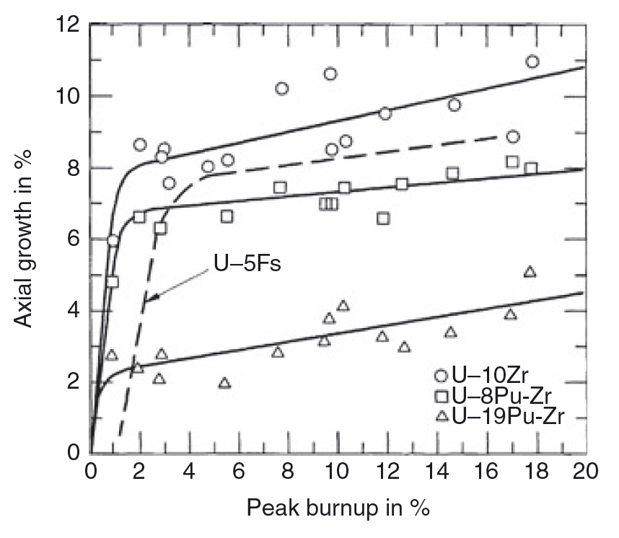
Swelling of Metallic Fuel
While oxide fuels well a few percent, metallic fuels swell by as much as 30 %
This swelling occurs very rapidly, e.g. in the first few percent burnup, then displays a linear increase
Swelling is accounted for by low smear density
Swelling rate decreases due to fission gas bubble interconnection and release
Low slope of swelling vs burnup for burnup > 3% is largely due to solid fission product generation

Slide 8
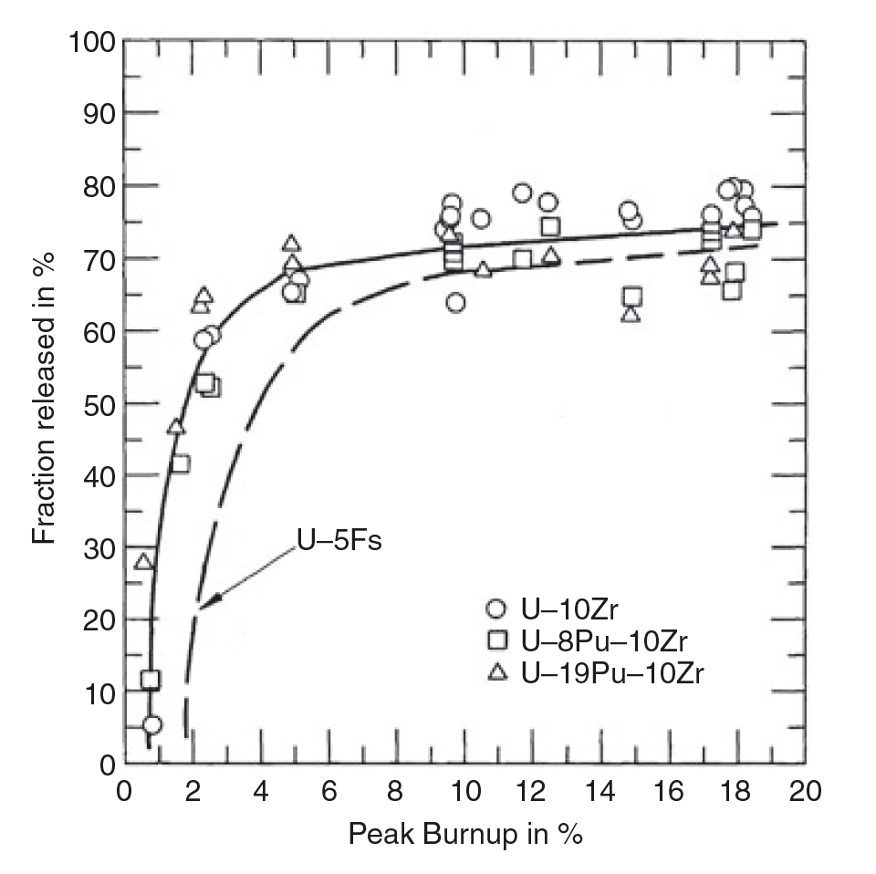
Fission Gas Release
Gas release is not wholly understood, but largely presumed to be intragranular bubble growth and interconnection
Bubble interconnection, and thus fission gas release, typically occurs within the first 3-5 percent burnup
There exists limited experimental data, but this is a key phenomenon affecting fuel swelling and performance

Slide 9
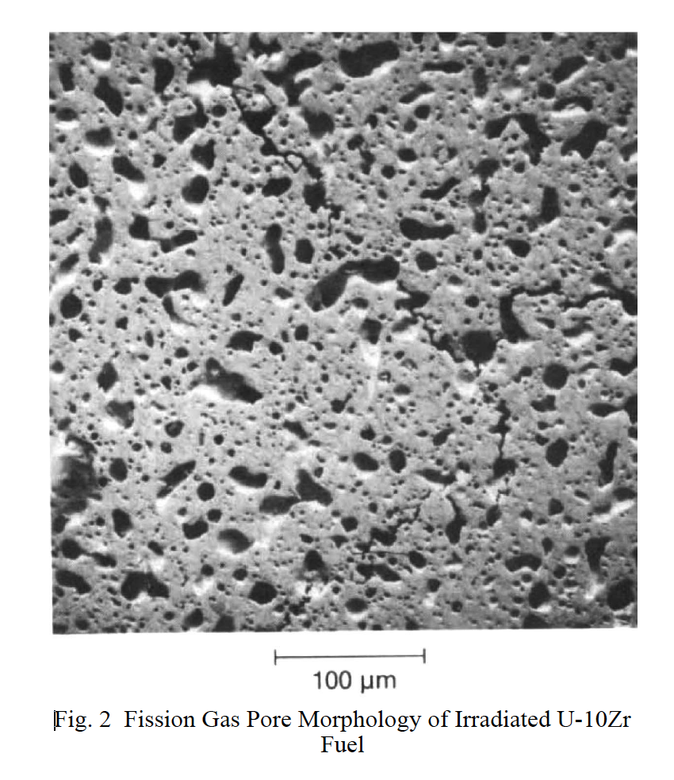
Fission Gas Bubble Morphology in gamma U

Slide 10
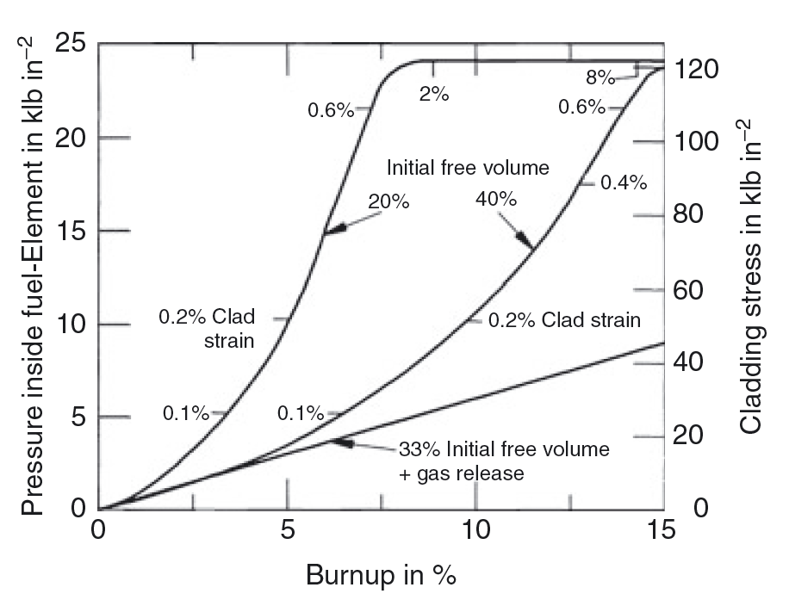
Cladding Strain

Slide 11
alpha U Tearing

Slide 12
alpha U-Zr Bubble Morpology

Slide 13
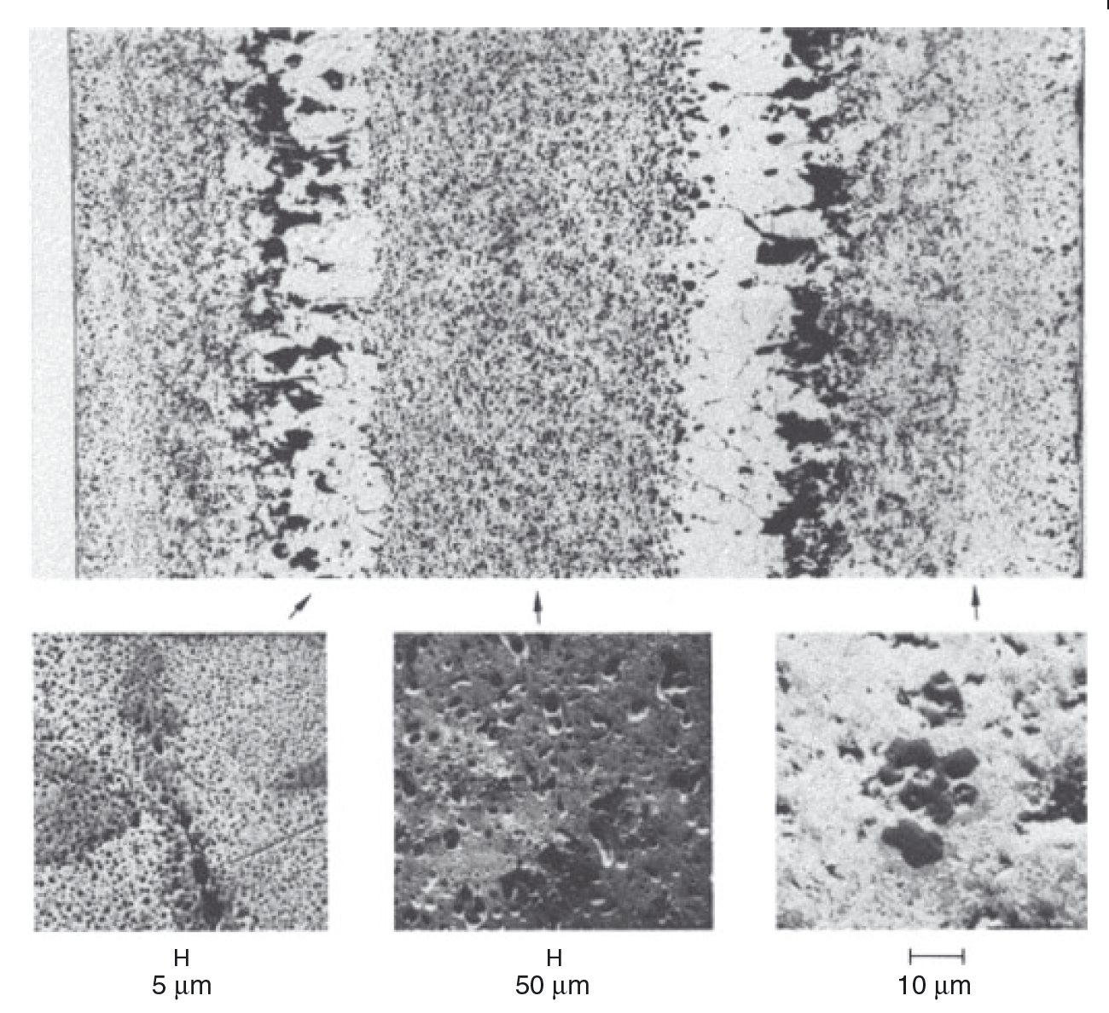
Radially Varying Bubble Morphologies

Slide 14
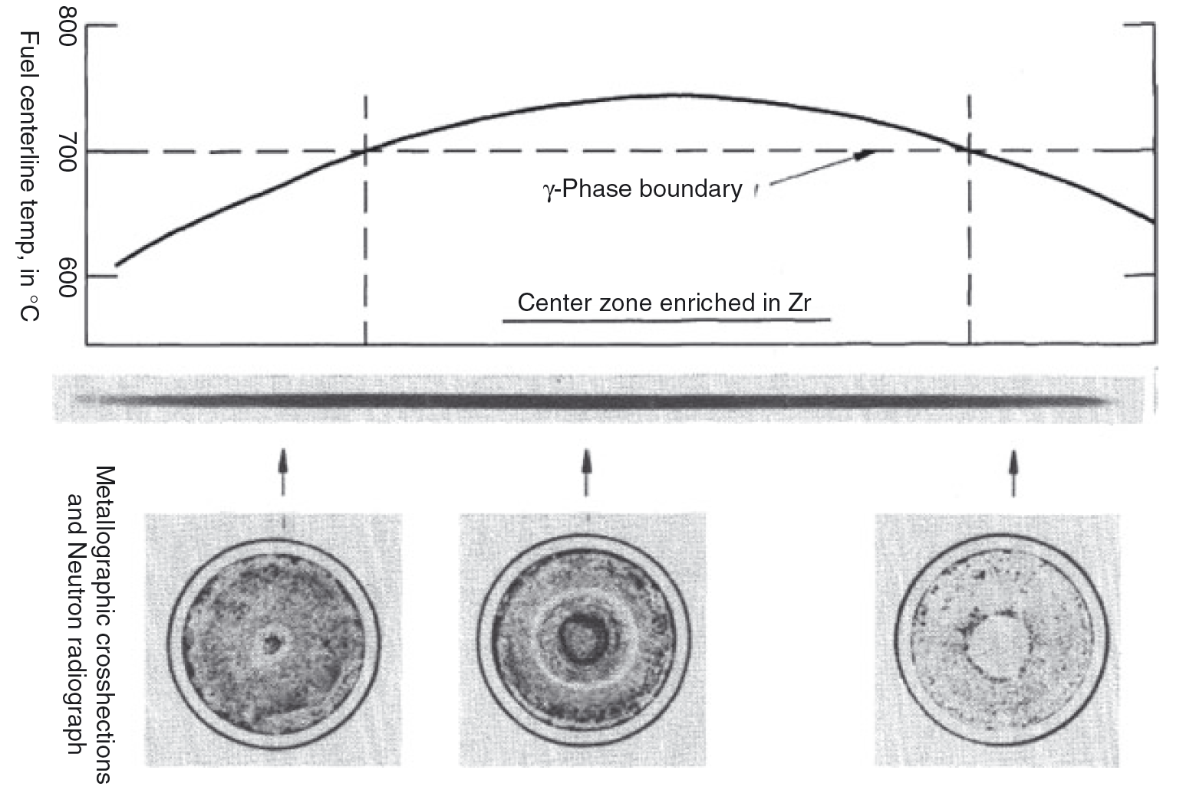
Axial Varying Microstructure

Slide 15
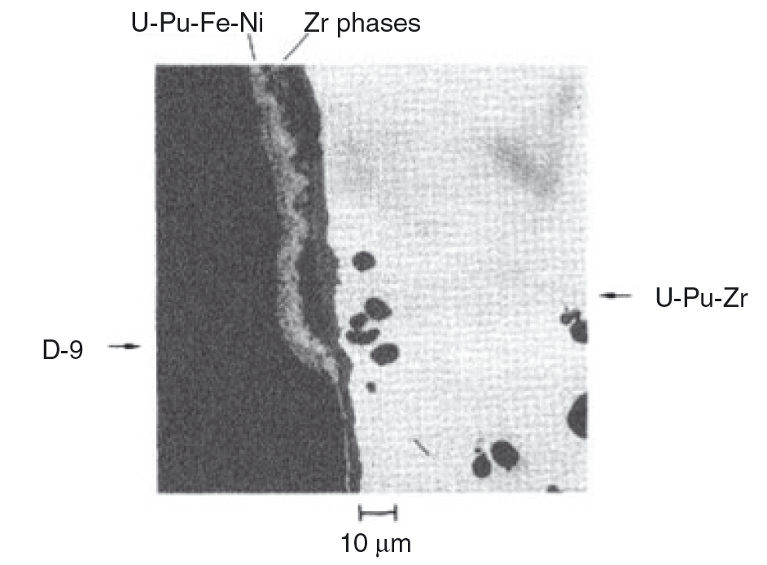
Fuel-Clad Chemical Interaction

Slide 16
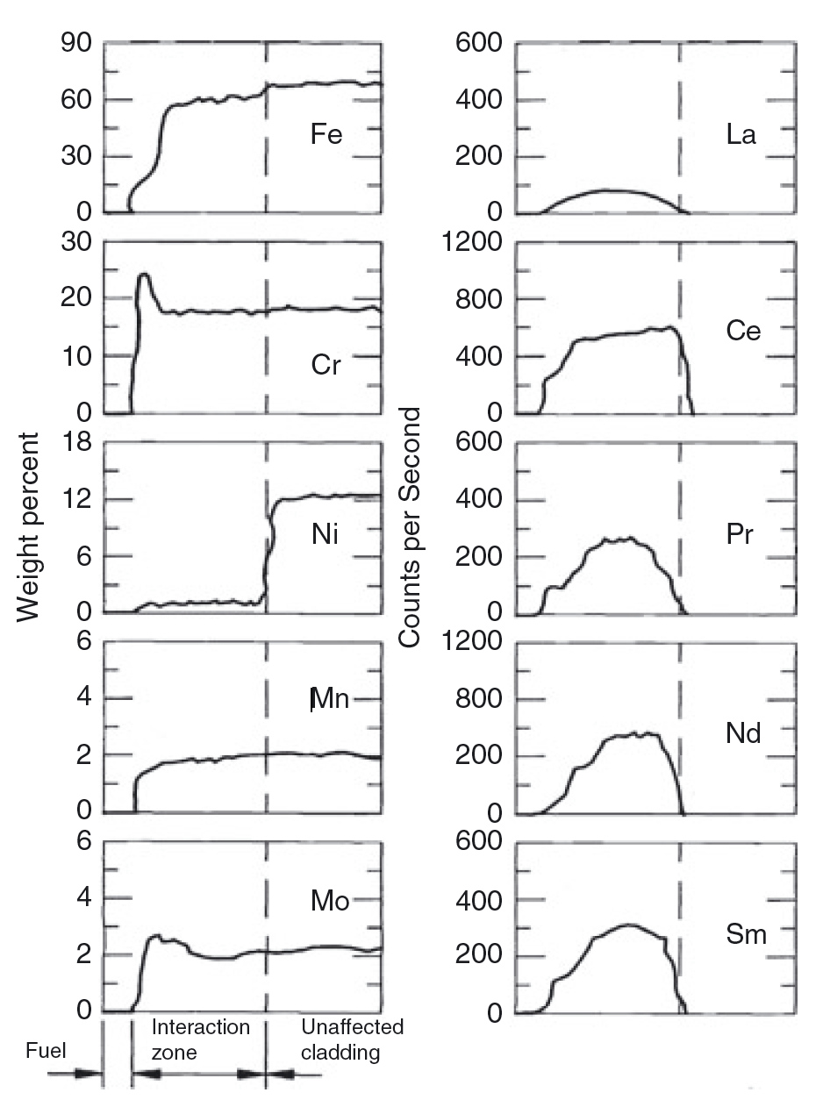
Chemical Species Interaction

Slide 17
Metallic Fuel Performance Modeling
The mechanical performance of the fuel is governed by a model that represents the elastic moduli as functions of temperature, porosity, and zirconium and plutonium content
A creep model that is a function of fission rate, temperature, and porosity is also used
Eigen strains (stress free strains) are modeled by constant thermal expansion along with gaseous and solid fission product swelling models
The solid swelling model is a straight-forward model directly proportional to fission rate
The gaseous swelling model comes from a force balance applied to a bubble with the metallic fuel and generates porosity at all material points (quadrature points) in the domain

Slide 18
Metallic Fuel Performance Modeling
The thermal conductivity model in the fuel is a function of temperature, porosity, and zirconium and plutonium content
The heat capacity models are functions of temperature and alloy phase.
The fission gas model is simply based on fission rate for gas generation and the fission gas released is governed by the value of porosity
Cladding mechanical response is governed by constant elastic moduli and thermal expansion, with thermal and irradiation creep
Thermal conductivity and heat capacity models are functions of temperature
The redistribution of zirconium is governed by Fickian and Soret diusion

Slide 19
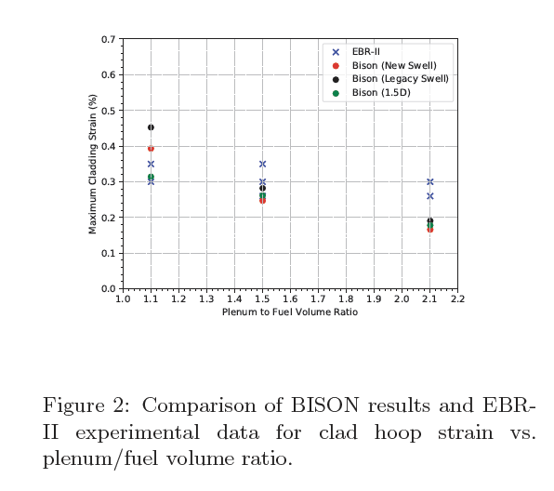
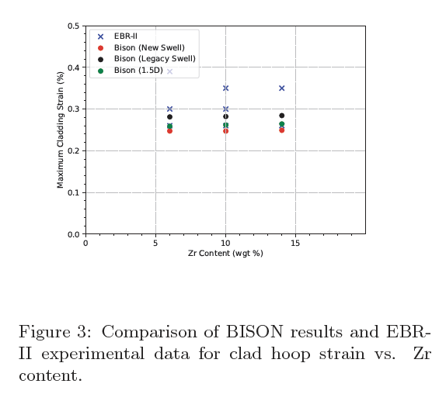
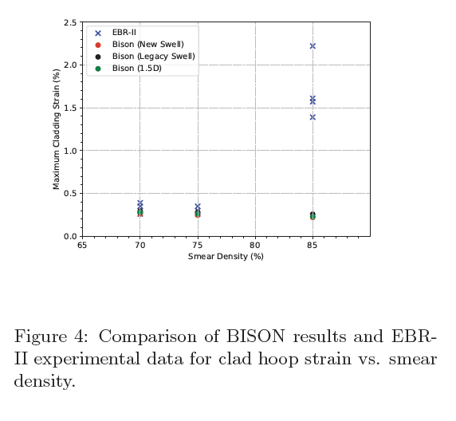
Metallic Fuel Performance Modeling
Compare BISON to EBR-II experiments

Slide 20
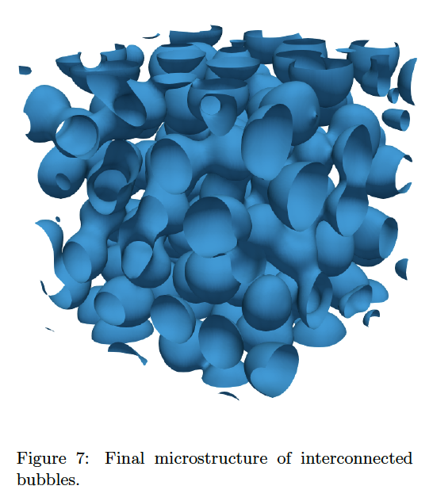
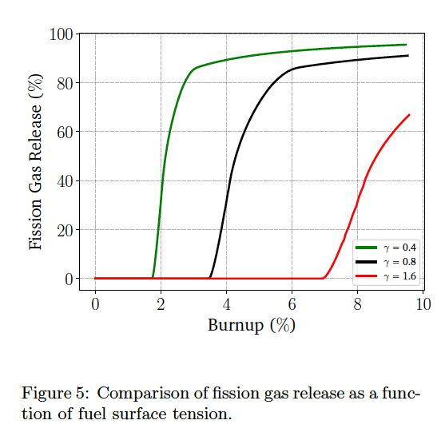
Incorporation of lower length scale information
Surface energy
Porosity interconnection threshold
Fission gas bubble number density
Alpha tearing/initial porosity

Slide 21
Summary

